Slide 1

GUI Design By Python

Slide 2
The entire structure of the system
Arduino
LabVIEW
Python
VISA
tkinter
TXT
GUI

Slide 3
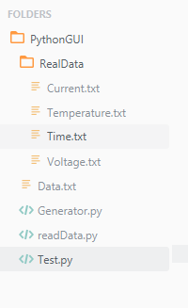
GUI Sample Structure
Interface
Generator
Random Data Structure
Real data generator

Slide 4
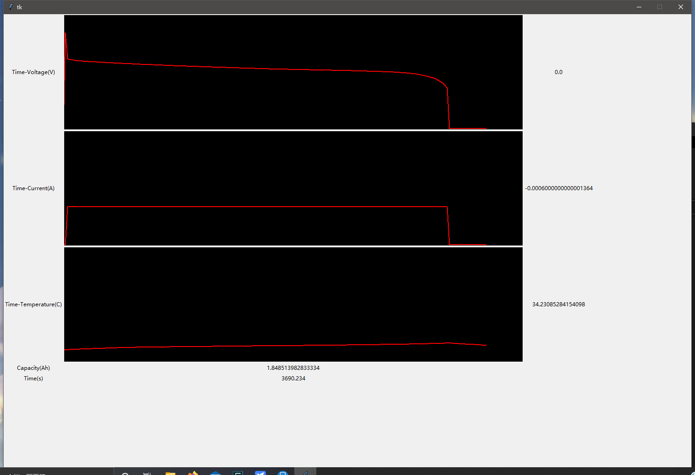
Interface
Time-Voltage Curve
Newest Measured Voltage Data
Time-Current Curve
Newest Measured Current Data
Time-Temperature Curve
Newest Measured Temperature Data
Capacity Calculated by Integral
Time Now

Slide 5
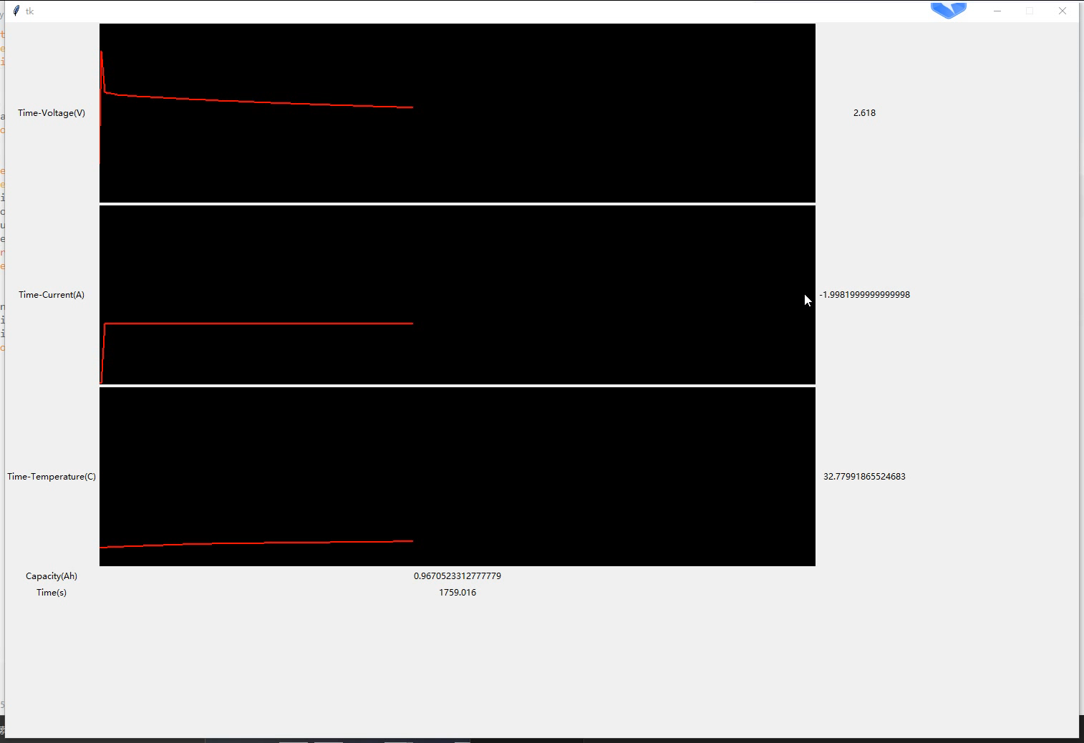
Sample

Slide 6

Thank you!

